Slide 1
MX2020 Big Data
Event Hub Reference Architecture
Mayo 10, 2019

Slide 2
Change control
Versión | Fecha | Descripción del Cambio | Autor/Departamento
1.0 | 10/05/2019 | Creation of the document | [Big Data Architecture]
1.1 | 02/07/2019 | Integration pattern diagram, general component diagram, internal structure diagram of the citiIntegration component and citiConsumerEngine are incorporated | [Big Data Architecture]

Slide 3
Table of Contents
Needs and Solution Proposal
Graphic Representation of the Solution
Infrastructure and Connectivity
General services
Risks and Dependencies
Standards, Patterns and Decisions of Architecture
References and Annexes

Slide 4
Needs and Solution Proposal (I)
Descripción de la solución técnica
Objective
Define core components, pieces of code for the CitiBanamex Even Hub Reference Architecture
Scope
Graphically represent the components, their integrations and the use of good practices in the development of software engineering processes.
Description
Event Hub is a highly scalable data streaming platform and event ingestion service, capable of receiving and procession millions of events per second. Event Hub can process and store events, data or telemetry produced by distributed software and devices. Data sent to an event hub can be transformed and stored using any real-time analytics provider or batching/storage adapters. With the ability to provide publish-subscribe capabilities with low latency and at massive scale, Event Hubs services as the “on-ramp” for Big Data.
Even Hub and telemetry handling capabilities make it especially useful for:
Application instrumentation
User expediencies or workflow processing
Enable behavior tracking in mobile apps, traffic information from web farms, connected with other devices

Slide 5













Needs and Solution Proposal (I)
Event Hub Architecture
Event Hub channels the events. So Event Hub is a component or services that is located between event editors and event consumers to decouple the production of event flow from the consumption of those events. The following figure represents this architecture:
Event Hub feature following key elements:
Event producers/publishers: An entity that sends data to an event hub.
Capture: Enables you to capture Event Hubs streaming data and store it in an Azure Blob storage account
Partitions: Enables each consumer to only read a specific subset, or partition, of the event stream.
Tokens: Identifies and authenticates the event publisher
Event consumers: An entity that reads event data from an event hub
Consumer groups : Provides each multiple consuming application with a separate view of the event stream, enabling those consumers to act independently.
Throughput units: Pre-purchased units of capacity. A single partition has a maximum scale of 1 throughput unit.
Even Produces
Collection
Ingress
Stream
Processing
Long-term
storage
Presentation /
Action
Application
Service bus
Stream
APIs
APIs
E
Stream
processing
DBs
E
Devices
Event Hub
Storage
Search and Query
Legacy Systems
Slow Data
Data Lake
Analytics
Heterogeneous
Data Sources
Reports

Slide 6
Needs and Solution Proposal (II)
Event Hub Architecture – Event streaming platform
App
App
App
App
A modern stream-centric data architecture
Social Graph
Search
Key Value Storage
Oracle
Newsfeed
OLAP
In Event-Hub Kafka acts as a type of universal channeling for data. Each system can feed this central duct or be fed by it; the applications or flow processors can access it to create new derived flows, which in turn can be fed back into the various systems to serve.
An event streaming platform has two primary uses:
Kafka
Streaming Platform
Stream processing: It enables continuous, real-time applications built to react to, process, or transform streams. This is the natural evolution of the world of Enterprise Messaging which focused on single message delivery, stream processing gives you that and more.
Data Integration: The event streaming platform captures streams of events or data changes and feeds these to other data systems such as relational databases, key-value stores, Hadoop, or
Log Search
App
Monitoring
Stream APIs
App
Principles of Even Hub
Security & Fraud
Stream
Processing
Most of what CitiBanamex does can be considered as a series of events
Data is more than rows in databases, they are events
Real Time Analytics
Storage Layer
Hadoop
Data Visualization tools
A modern stream-centric data architecture

Slide 7
Needs and Solution Proposal (III)
Event Hub Architecture – The key capabilities of an Event Hub
Event Hub | Description
Pub / Sub | Enable real-time publishing and subscribing to data streams at scale, in particular: Provide single-digit latency so it is usable by real-time applications Able to handle high volume data streams such as are common for log data, or other usage across many applications Enable integration with passive data systems such as databases as well as applications that actively publish events
Process | Enable the real-time stream processing of streams at scale Support modern stream processing capabilities to power real-time applications or streaming transformations
Store | Be able to reliably store streams of data at scale. In particular: It provides solid guarantees of replication and order to handle critical updates, such as replicating the record of changes in a database in a replica store as a search index, delivering this data in order and without loss. It is capable of storing or storing data for long periods of time. This allows integration with batch systems (such as a data warehouse) that only load data periodically, as well as allowing the flow processing systems to reprocess the sources when their logic changes. Storage must be economical enough for the platform to be viable at scale.

Slide 8
Needs and Solution Proposal (IV)
Event Hub Architecture – The key capabilities of an Event Hub
Points to highlight about the relationship this event streaming platform concept has with other.
System | Description
Messaging | Even Hub is similar to an enterprise messaging system: it receives messages and distributes to interested subscribers. It is considered as a type of messaging 2.0. There are three important differences: Messaging systems usually run in single implementations for different applications. Because Even Hub runs as a cluster and can be scaled, a central instance can support a complete data center The messaging systems have limitations in the work of data storage and this limits them to flows that only have consumption in real time. However, many integrations require more than this The semantics of messaging systems are not easily compatible with rich flow processing, so they really can not be used as the basis for the processing of Even Hub
Data Integration Tools | Enable the real-time stream processing of streams at scale Support modern stream processing capabilities to power real-time applications or streaming transformations One practical area of overlap is that by making the data available in a uniform format in one place with a common abstraction stream, many of the routine data cleaning tasks can be completely avoided
Enterprise Service Buses | The advantage of Even Hub is that the transformation is fundamentally decoupled from the flow itself. This code can live in applications or transmit processing tasks, allowing teams to go their own pace without a central bottleneck for the development of the application.
Change Capture Systems | Databases have long had similar log mechanisms such as Golden Gate. However these mechanisms are limited to database changes only and are not a general purpose event capture platform. They tend to focus primarily on the replication between databases, often between instances of the same database system (e.g. Oracle-to-Oracle).

Slide 9
Needs and Solution Proposal (V)
Event Hub Architecture – The key capabilities of an Event Hub
Points to highlight about the relationship this event streaming platform concept has with other.
System | Description
Data Warehouses and Apache Hadoop | Event Hub does not replace data warehouse; It acts as a conduit for data to flow quickly for long-term retention, ad hoc analysis and batch processing. That same channel can be executed in reverse to publish the results derived from the processing by night or hourly batches.
Stream Processing Systems | External flow processing structures, such as Storm, Samza, Flink or Spark Streaming, can be used to provide the capacity of a transmission platform. They try to add additional processing for transformations in real time

Slide 10


Needs and Solution Proposal (VI)
Mirror Maker
Replicates cluster data to another datacenter
Event Hub Architecture – Kafka Connect
Consumer over REST/JSON
Brokers
Kafka Cluster (Brokers, Zookeeper)
Kafka Consumer
Kafka Cluster (Brokers, Zookeeper)
Serving Layer
Kafka REST Proxy
1.
Kafka Cluster (Brokers, Zookeeper)
Job Stream
Kafka Producer
Kafka Cluster (Brokers, Zookeeper)
Transforms Creates new streams Aggregates Joins Analysis
Stream APIs
2.
Name Events (Topic)
Kafka Cluster (Brokers, Zookeeper)
Kafka Steam / SQL
Prepackaged Connectors for input (source)
Name Events (Topic)
Indexed for Search
Search
Name Events (Topic)
3.
Name Events (Topic)
Job Real Time Analytics
Name Events (Topic)
Key Value Storage
Name Events (Topic)
4.
Business Intelligence
Name Events (Topic)
Kafka Connect
Sources
Name Events (Topic)
Job Real Time Analytics
Name Events (Topic)
Oracle
5.
Name Events (Topic)
Prepackaged Connectors for output (source)
Name Events (Topic)
Name Events (Topic)
Name Events (Topic)
Kafka Connect
Sink
Data Bases
Newsfeed
Name Events (Topic)
6.
Name Events (Topic)
Name Events (Topic)
Name Events (Topic)
Cognitive
OLAP
Name Events (Topic)
7.
Name Events (Topic)
Output Data Streams
S3
Name Events (Topic)
Log aggregation
n…
Input Data Stream
Name Events (Topic)
Host standby
cluster for disaster recovery in another data center

Slide 11
Needs and Solution Proposal (VII)
Event Hub Architecture – Integration Patterns
Event Producer
Event Hub
Event Consumer
Event Producer
Stream App
Stream App
A
Stream App
A
Kafka Custom API Source
Eclipse CRP
B
MQ/JMS/Kafka Custom API Source
B
Solace/Kafka Custom API Source
ATM´s
Kafka Connect Cluster – Worker 3
Kafka Cluster
(Brokers, Zookeeper)
Kafka Connect Cluster – worker 3
C
Name Events (Topic)
JDBC/ Kafka Custom API Source
Alertas
C
Kafka Connect Cluster – Worker 2
Kafka Cluster
(Brokers, Zookeeper)
Kafka Connect Cluster – worker 2
D
Name Events (Topic)
Name Events (Topic)
Name Events (Topic)
A
Name Events (Topic)
EMS/ Kafka Custom API Source
Name Events (Topic)
CAP
E
Kafka Connect Cluster – Worker 1
Kafka Cluster
(Brokers, Zookeeper)
Kafka Connect Cluster – worker 1
COP
D
Name Events (Topic)
Name Events (Topic)
Name Events (Topic)
Name Events (Topic)
Name Events (Topic)
Data Capture
Name Events (Topic)
Name Events (Topic)
B
F
Name Events (Topic)
TECOS
Name Events (Topic)
Abinitio ETL
E
Name Events (Topic)
Name Events (Topic)
G
TIBCO
Connector 1
Task 1
Name Events (Topic)
Connector 1
Task 1
Name Events (Topic)
Name Events (Topic)
Name Events (Topic)
Name Events (Topic)
Event Consumer
Name Events (Topic)
C
EAP
F
Name Events (Topic)
Name Events (Topic)
Name Events (Topic)
IBM
Name Events (Topic)
Connector 3
Task 1
Name Events (Topic)
Name Events (Topic)
Connector 3
Task 1
Name Events (Topic)
Name Events (Topic)
A
JDBC/Kafka Connector Source
Name Events (Topic)
Kafka Connect
Sink
D
F
Name Events (Topic)
Mongo
Oracle
Name Events (Topic)
Kafka Custom API Sink
Name Events (Topic)
Name Events (Topic)
Name Events (Topic)
Name Events (Topic)
Name Events (Topic)
B
Connector 2
Task 2
Name Events (Topic)
Name Events (Topic)
Connector 2
Task 2
HDFS/Hive/Kafka Custom API Sink
F
Name Events (Topic)
E
Engine Evaluator
C
Tandem
Name Events (Topic)
Name Events (Topic)
AbInitio ETL
Name Events (Topic)
Name Events (Topic)
Name Events (Topic)
D
Abinitio ETL
Data Capture
Connector 3
Task 1
Name Events (Topic)
Connector 3
Task 1
Name Events (Topic)
Name Events (Topic)
Name Events (Topic)
Name Events (Topic)
Name Events (Topic)
Unisys
G
Name Events (Topic)
Name Events (Topic)
AbInitio
ETL

Slide 12
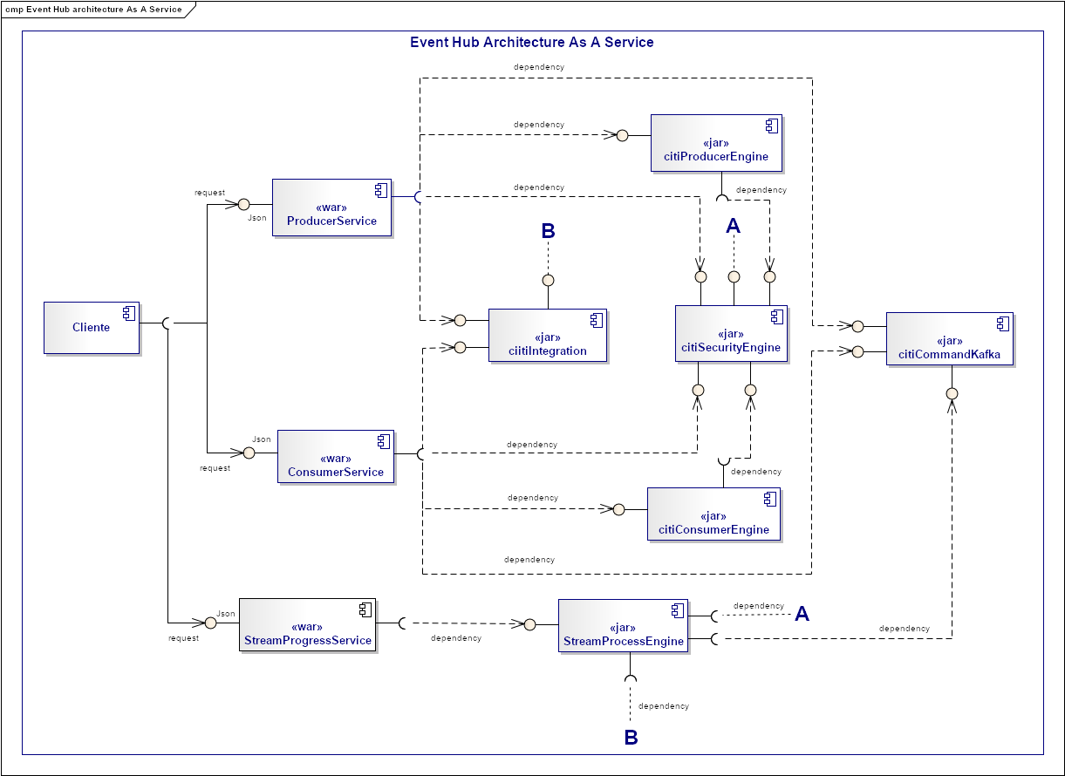
Needs and Solution Proposal (VIII)
Componente nuevo
Componente a modificar
Event Hub Architecture – Components I
Componente no contemplado

Slide 13
Needs and Solution Proposal (IX)
Event Hub Architecture – Components II
<< uses >>
StreamProcessEngine
ConsumerService
Kafka REST Proxy)
<< uses >>
B
Tibco
ProducerService
(Kafka REST Proxy)
Kafka Cluster (Brokers, Zookeeper)
Serving Layer
Kafka Cluster (Brokers, Zookeeper)
<< uses >>
A
Solace
StreamProgressService
Kafka REST Proxy)
Name Events (Topic)
Kafka Cluster (Brokers, Zookeeper)
Stream APIs
Name Events (Topic)
Kafka Connect
Sources
Name Events (Topic)
Kafka Connect
Sink
Search
3.
Name Events (Topic)
Indexed for Search
<< uses >>
Name Events (Topic)
Name Events (Topic)
<< uses >>
Key Value Storage
ciitiIntegration
(Source)
4.
Name Events (Topic)
Name Events (Topic)
Business Intelligence
Name Events (Topic)
ciitiIntegration
(Sink)
<< uses >>
Name Events (Topic)
COP
5.
CitiProducerEngine
Name Events (Topic)
Name Events (Topic)
<< uses >>
Name Events (Topic)
<< uses >>
Name Events (Topic)
Newsfeed
Name Events (Topic)
citiConsumerEngine
B
Data Bases
6.
cmpComandKafka
Name Events (Topic)
Name Events (Topic)
Name Events (Topic)
OLAP
7.
Name Events (Topic)
Cognitive
citiSecurityEngine
Name Events (Topic)
S3
Log aggregation
Name Events (Topic)
n…
A
<< uses >>

Slide 14
Needs and Solution Proposal (X)
Event Hub Architecture – The steps of the architecture for the processing engine
Read the individual events of a Kafka theme (input messages)
Validate the message and send any defective event to a topic dedicated to Kafka called invalid messages
Write the enriched messages in a Kafka theme called valid messages
Input-messages
r1
r2
r3
r4
r5
r6
Processing Engine
Valid-messages
READ
Validation
Enrichment
WRITE
v1
v2
v3
v4
v5
v6
WRITE
invalid-messages
i1
i2
i3
i4
i5
i6

Slide 15
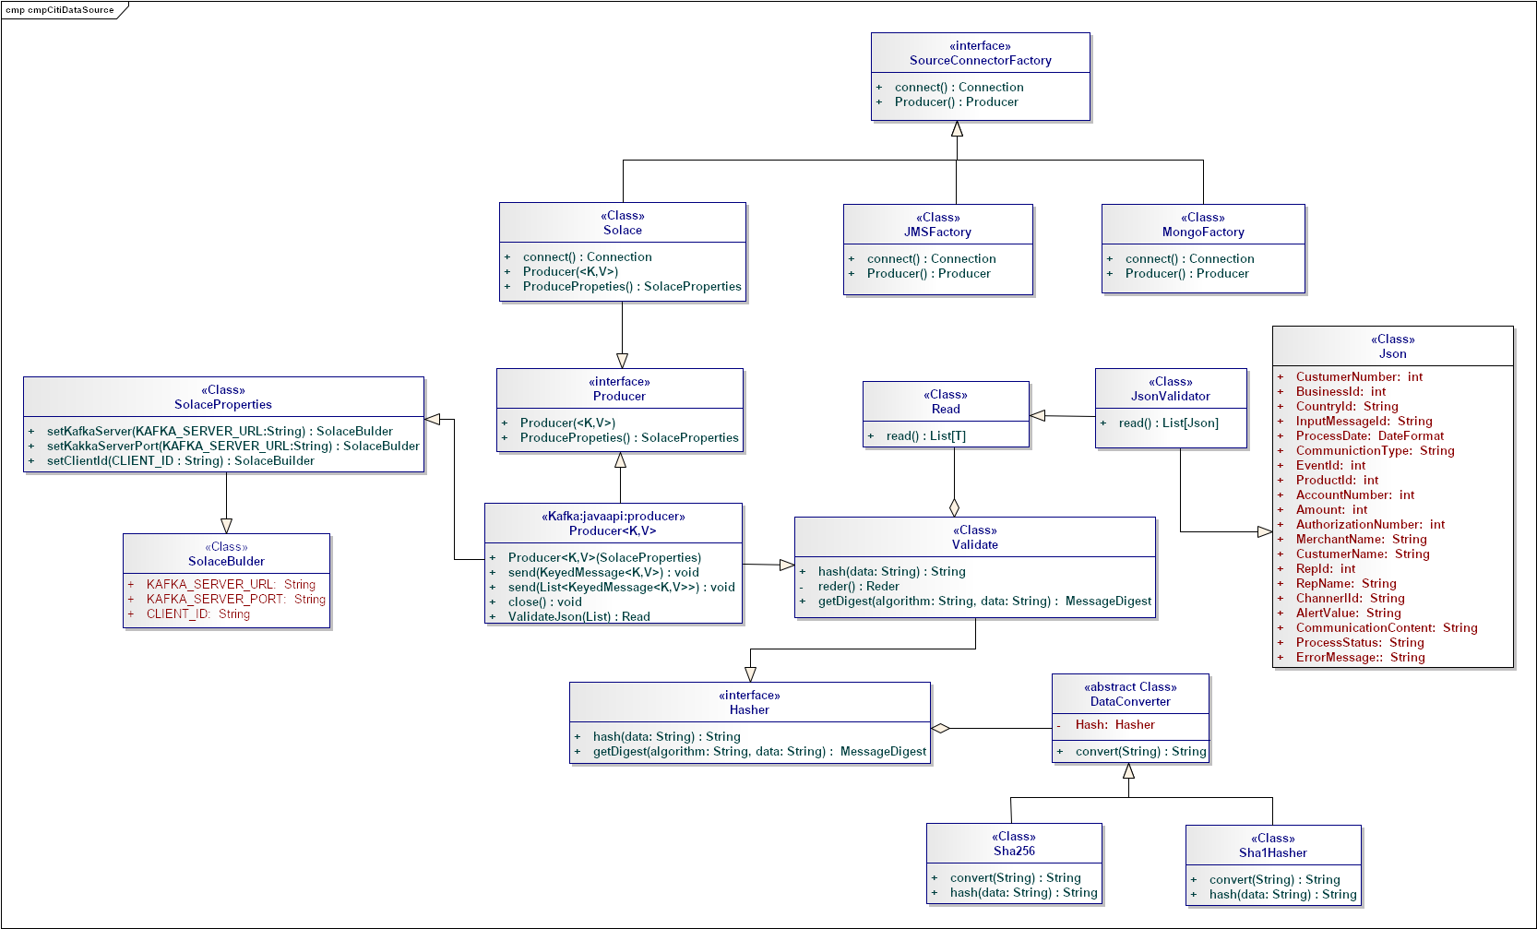
Needs and Solution Proposal (XI)
Event Hub Architecture Internal Structure Of citiIntegration (Source)

Slide 16
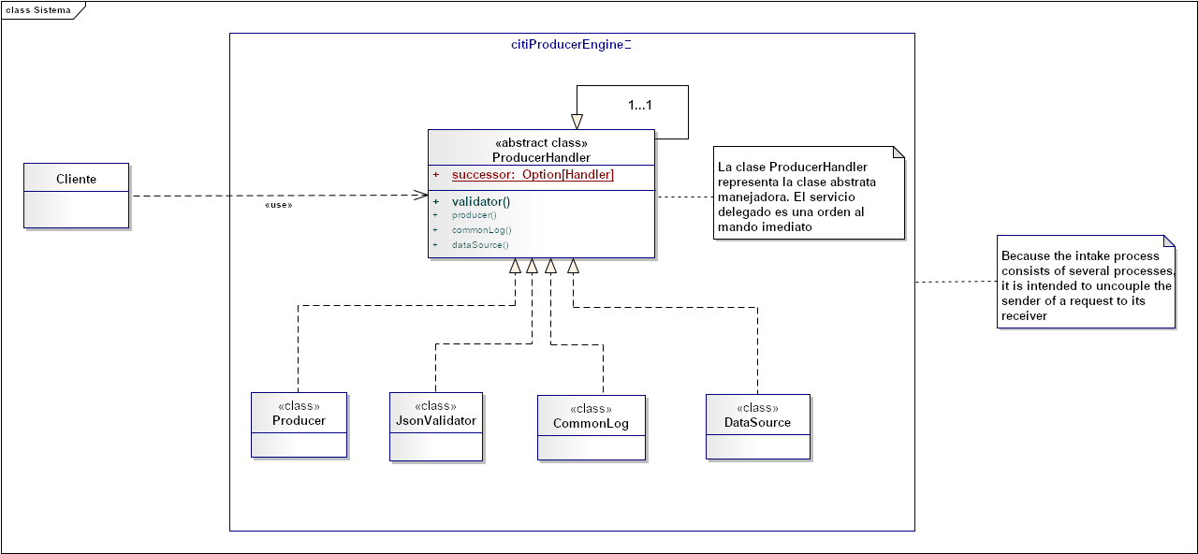
Needs and Solution Proposal (XII)
Architecture Internal Structure Of citiProducerEngine

Slide 17
Needs and Solution Proposal (XIII)
Event Hub Architecture – Even Driver
The three mechanisms through which services interact
Service
Commands are actions—requests for some operation to be performed by another service, something that will change the state of the system. Commands execute synchronously and typically indicate completion, although they may also include a result.
Example: processPayment(), returning whether the payment succeeded.
When to use: On operations that must complete synchronously, or when using orchestration or a process manager. Consider restricting the use of commands to inside a bounded context.
Events are both a fact and a notification. They represent something that happened in the real world but include no expectation of any future action. They travel in only one direction and expect no response (sometimes called “fire and forget”), but one may be “synthesized” from a subsequent event.
Example: OrderCreated{Widget}, CustomerDetailsUpdated{Customer}
When to use: When loose coupling is important (e.g., in multiteam systems), where the event stream is useful to more than one service, or where data must be replicated from one application to another. Events also lend themselves to concurrent execution.
Queries are a request to look something up. Unlike events or commands, queries are free of side effects; they leave the state of the system unchanged.
Example: getOrder(ID=42) returns Order(42,…)
When to use: For lightweight data retrieval across service boundaries, or heavyweight data retrieval within service boundaries.
REQUEST - DRIVEN
EVENT - DRIVEN
serviceNameWidget()
Command
Logic
“Widget - Just happened”
Event
State
Change
No state
change
getListService(parameter)
Query
Commands, events, and queries

Slide 18

Needs and Solution Proposal (XIV)
Event Hub Architecture – Even Driver
Others work out what they should do next
I broadcast what I did
Logic
Logic
Kafka
Logic
Queries don´t span context, they use a local copy of the replicated events
Logic
Event-driven approaches demonstrating how event-driven approaches provide less coupling

Slide 19
Needs and Solution Proposal (XV)
Event Hub Architecture – Even Driver Core
Synchronous Edge
Service
UI Tier
Kafka
Kafka
Kafka
Event Driver Core
Kafka
Event Only

Slide 20
Needs and Solution Proposal (XVI)
Event Hub Architecture – Even Producer APIs

Slide 21
Needs and Solution Proposal (XI)
Event Hub Architecture – Even Producer APIs Streams and KSQL

Slide 22
Needs and Solution Proposal (XII)
Event Hub Architecture – Event Driven Services
El job lee el contenido de los archivos y realiza transformaciones

Slide 23
Big Data Process
Agile and DevOps
Continuous Delivery / Deployment (CD)
Code
Build
Integrate
Test
Release
Deploy
Operate
Agile Development
Continuous Integration
Continuous Delivery
Continuous Delivery
DevOps

Slide 24










Big Data Process
Agile and DevOps
Integration and continuous deployment
Pull
Download & Test
Test Automation
Source code repository
Binary repository
Deploy
Download & Deploy
Push
{Dev}
Compilation tool
Developer
Package & Test
Task Orchestrator
Even Hub Citi
or
Analyze
static code analysis
RML

Slide 25
Infrastructure and Connectivity (I)
Resumen de Componentes de Infraestructura
Infrastructure component | Description | Applicability (New, Modified, Unmodified) | Application in which the component is located

Slide 26
Volumetría (I)
Case of use -
Characteristic | Detalle

Slide 27
Volumetría (II)
Case of use -
Characteristic | Detalle

Slide 28
Volumetría (III)
Case of use -
Characteristic | Detalle

Slide 29
Servicios Generales (I)
Seguridad
El detalle de los lineamientos mencionados están definidos en los documentos:
Estándares
Confidencialidad
Comunicación por medio de autenticación mutua entre Teredarta y Data Lake
Auditoria:
Generación de Logs.

Slide 30
Risks and Dependencies (I)
Coexistence
El detalle de los lineamientos mencionados están definidos en los documentos:
Validar si hay estándares de seguridad
Riesgos
El detalle de los lineamientos mencionados están definidos en los documentos:
Validar si hay estándares de seguridad

Slide 31
Risks and Dependencies (II)
Dependencias
El detalle de los lineamientos mencionados están definidos en los documentos:
Estándar Controles de Seguridad para aplicativos de GFS México. (Respecto a los apartados de aplicaciones internas y controles de procesamiento)
Estándar de Controles de Seguridad. Versión 1.0 Riesgo

Slide 32
Standards, Patterns and Decisions of Architecture (I)
Exceptions to Standards and Architecture Patterns
…

Slide 33
Standards, Patterns and Decisions of Architecture (II)
Architecture Decisions
Decisión | Premisas | Razonamiento de la Decisión
You opt for a local solution | The solution proposes an application developed in Scala, Spark or PySpark

Slide 34
Standards, Patterns and Decisions of Architecture (III)
Dependencias
Dependencia | Componente externo a la solución que impacta | Fecha estimada en la que se requiere disponible
No Aplica | No Aplica | No Aplica

Slide 35
References and Annex (I)
References
Nombre y version | Fecha | Comentarios | Rol/Departamento

